Slide 1
Multi-Agent Smart Supply Chain Optimizer
Powered by LangChain
By VANGA PAVAN KALYAN

Slide 2
Problem Statement:
Modern supply chains are highly complex and dynamic, often suffering from stockouts, delivery delays, high costs, and vulnerability to disruptions such as strikes or weather events. Managing them requires simultaneous consideration of inventory data, supplier options, transport routes, and risk alerts, which is difficult for traditional single-agent or rule-based systems.

Slide 3
Proposed Solution:
To address this, we propose building a Collaborative Multi-Agent Smart Supply Chain Optimizer powered by LangChain, where specialized agents work in parallel and exchange information dynamically rather than executing in a rigid sequence:
Inventory Management Agent
Supplier Agent
Route Optimization Agent
Risk Management Agent
Planner/Manager Agent

Slide 4
Multi-Agent Roles (Overview):
Inventory Management Agent:
  Continuously monitors warehouse and ERP systems.
  Predicts when stockouts may occur.
  Ensures proactive replenishment.
Supplier Agent:
  Identifies potential vendors from databases/APIs.
  Compares pricing, delivery times, and reliability.
  Maintains a history of supplier performance.
Route Optimization Agent:
  Plans delivery paths using routing APIs.
  Considers traffic, distance, and transport modes.
  Learns from past delivery performance to improve efficiency.

Slide 5
Risk Management Agent:
  Tracks weather, geopolitical risks, and transport alerts.
  Provides early warnings to other agents.
  Suggests mitigation strategies for disruptions.
Planner/Manager Agent:
  Acts as the “brain” of the system.
  Integrates all agent inputs.
  Resolves conflicts (e.g., cost vs. speed vs. risk).
  Generates the final optimized supply chain plan.

Slide 6
Individual Memory per Agent:
Inventory Management Agent: Maintains a log of historical stockouts, demand fluctuations, and reorder thresholds to improve future predictions.
Supplier Agent: Keeps memory of supplier performance (delivery times, past negotiations, pricing history) to recommend the most reliable options.
Route Optimization Agent: Learns from previous routes, delays, and real-time traffic data to improve efficiency in future planning.
Risk Management Agent: Tracks recurring disruptions such as seasonal weather issues, strikes, or regional risks, enabling better forecasting.
Planner/Manager Agent: Stores previous conflict resolutions, decision rationale, and user/company preferences to ensure consistent long-term strategies.

Slide 7
Memory Persistence Details:
Purpose:
Ensures agents retain useful history across sessions, supporting long-term reasoning and adaptive learning.
Agent-Specific Persistence:
  Inventory Management Agent→ Stores demand and stockout patterns for 24 months → supports seasonal forecasting.
  Supplier Agent → Remembers vendor performance scores and reliability across all past interactions → improves trust-based selection.
  Route Optimization Agent → Retains travel times, delays, and routes for 12 months → enhances future routing.
  Risk Management Agent → Keeps disruption history (floods, strikes, weather) for 12 months → identifies recurring risks.
  Planner/Manager Agent → Logs conflict resolutions and decision rationales for the entire project lifecycle → ensures consistency.
Benefit:
Memory persistence makes the system smarter over time, not just reactive in a single run.

Slide 8
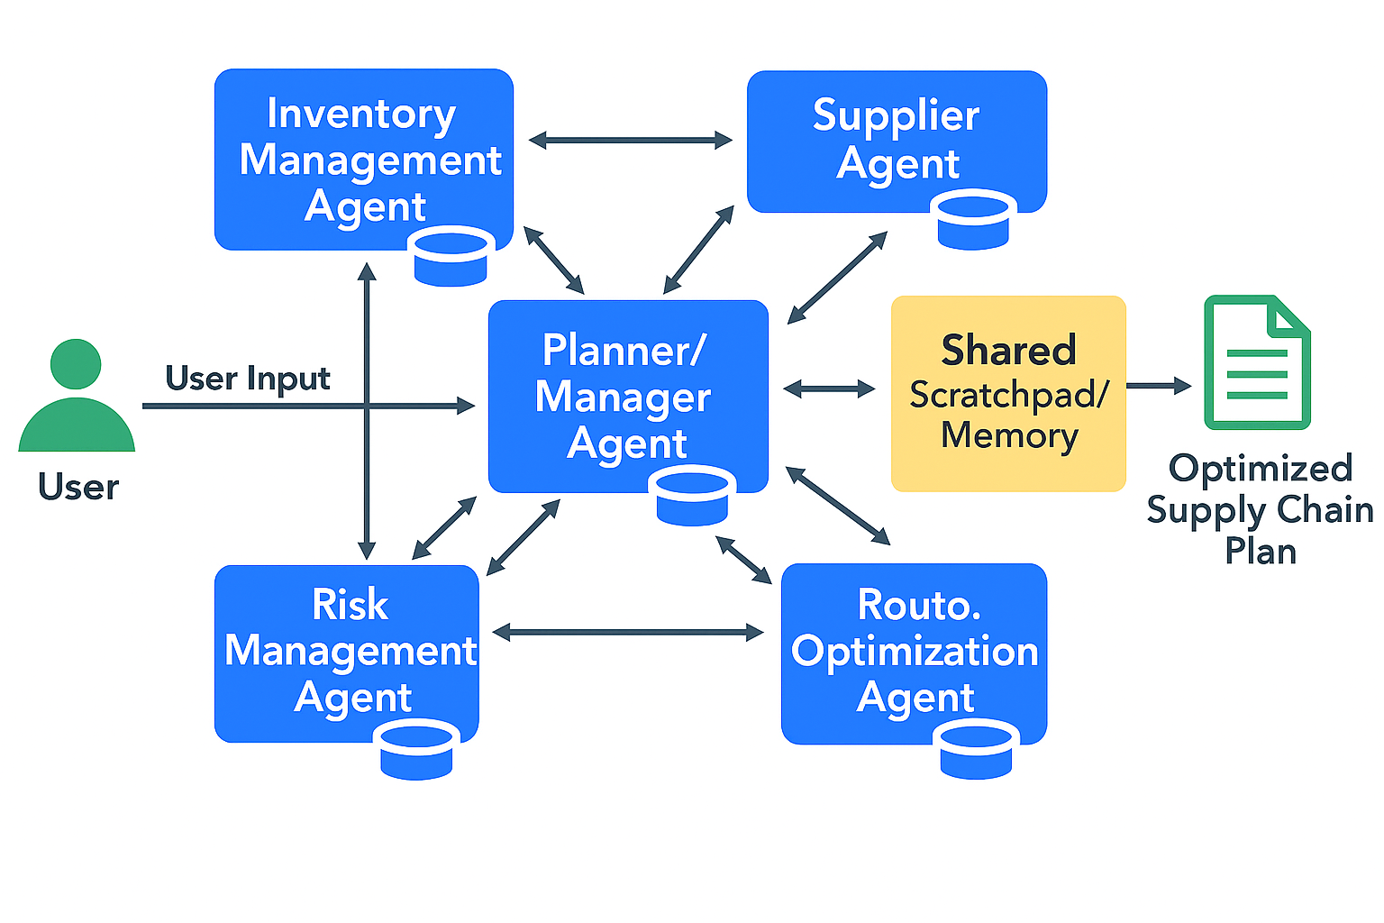
System Architecture:

Slide 9
How the Multi‑Agent Smart Supply Chain Optimizer Works?:
User / System Input:
  ERP data (inventory, orders) and external feeds (weather, routes, supplier info).
Agents Perform Specialized Tasks:
  Inventory Management Agent → Monitors stock levels, forecasts shortages.
  Supplier Agent → Evaluates vendors based on cost, lead time, reliability.
  Route Optimization Agent → Plans efficient routes using live traffic & disruptions.
  Risk Management Agent → Monitors weather, strikes, natural disasters.
  Planner/Manager Agent → Integrates all inputs, resolves conflicts, finalizes plan.
Communication & Collaboration:
  Agents exchange information dynamically through a shared scratchpad and direct JSON-based messages.
  Example: Risk Agent flags flood → Route Agent recalculates → Inventory updates ETA → Planner switches supplier.

Slide 10
Decision Logging & Explainability
  Each agent outputs structured JSON logs explaining decisions and trade-offs.
Example:
  {
  "Planner": "Vendor B selected",
  "trade_off": "+5% cost, avoids 3-day delay“
  }
Memory Persistence
Agents store long-term context:
  Supplier Agent → vendor reliability history.
  Risk Agent → seasonal disruptions (12 months).
  Planner → past trade-offs for consistent decisions.
Final Output
  Optimized supply chain plan (supplier + route + ETA).Transparent, auditable logs visible to user.

Slide 11
Communication & Collaboration:
Shared Scratchpad: Acts as a collaborative memory where all agents record findings, ensuring consistency and preventing redundancy.
Direct Agent-to-Agent Dialogue: Inventory, Supplier, Route, and Risk Agents can query each other directly, reducing dependency on a single central planner.
Parallel Interaction: Instead of waiting in sequence, agents work concurrently, making the system faster and more adaptive.
Transparency: The entire chain of communication is visible, allowing the user or business to track how final decisions are made.

Slide 12
Conflict Resolution Example: Multi-Agent Smart Supply Chain Optimizer
Scenario:
  Supplier Agent → Vendor A (cheapest option, but slow delivery).
  Route Agent → Reports Vendor A adds 3-day delay.
  Risk Agent → Flags Vendor A’s region as high disruption risk.
  Inventory Management Agent→ Warns of stockout if Vendor A is chosen.
Planner/Manager Resolution:
  Evaluates trade-offs:
    Vendor A → lowest cost, but high risk + delay.
    Vendor B → +5% cost, but 2 days faster and more reliable.
Decision: Choose Vendor B.

Slide 13
Logs:
{
"conflict": {
"supplier": {
"VendorA": {
"cost": "Lowest",
"delay": "+3 days",
"reliability": "65%"
},
"VendorB": {
"cost": "+5%",
"delay": "On-time",
"reliability": "92%"
}
},
"risk": "Vendor A region flagged high disruption"
},
"planner_decision": {
"chosen_vendor": "Vendor B",
"reason": "Higher reliability and faster delivery",
"trade_off": "+5% cost but avoids stockout ($10,000 lost sales avoided)"
}
}

Slide 14
Outcome:
Transparent, quantitative reasoning.
Ensures trust in Planner’s final decision.

Slide 15
Data Sources / APIs:
Inventory Management Agent:
  Source: Mock CSV/JSON dataset (stock levels, reorder points, demand forecasts).
  Input: Current stock, threshold levels.
  Output: Shortage alerts, forecasted restock needs.
Supplier Agent:
  Source: Mock CSV/JSON dataset (vendor name, cost, lead time, reliability score).
  Input: Product and quantity request.
  Output: Ranked vendor options with cost, lead time, and reliability.
Route Optimization Agent:
  Source: OpenRouteService API (Free).
  Input: Origin/destination coordinates, transport mode.
  Output: Optimized delivery route, distance, ETA, alternative paths.

Slide 16
Risk Management Agent:
  Source: OpenWeatherMap API (Free).
  Input: Location (city or coordinates).
  Output: Real-time weather alerts (e.g., flood, storm, heatwave).
Planner / Manager Agent:
  Source: Integrates outputs from all agents.
  Input: Results from Inventory, Supplier, Route, and Risk agents.
  Output: Final optimized supply chain plan with conflict resolution and JSON decision logs.

Slide 17
Feedback Loop in Action:
Scenario:
  The Risk Agent detects heavy rainfall and flooding on the main delivery route.
  The Route Optimization Agent recalculates a new path → adds 2 extra days.
  The Inventory Management Agent updates ETA and flags a stockout risk.
  The Supplier Agent checks Vendor B (alternative supplier) → faster lead time.
  The Planner/Manager Agent integrates all inputs and switches order to Vendor B with a safer route.
Outcome:
  Disruption avoided through real-time collaboration.
  System demonstrates memory-based reasoning (agents recall past delays and supplier reliability).
  Feedback loop ensures continuous adaptation and resilience.

Slide 18
Feedback Loop in Action – Supplier Delay:
Scenario:
  The Supplier Agent reports a delay from Vendor A (e.g., shipment will arrive 3 days late).
Flow:
  Supplier Agent → flags vendor delay.
  Inventory Management Agent→ updates ETA and identifies a potential stockout.
  Risk Agent → checks business impact of the delay (lost sales, service levels).
  Planner/Manager Agent → weighs alternatives:
    Option A: Switch to Vendor B (higher cost, faster lead time).
    Option B: Use express shipping from Vendor A.
    Option C: Reallocate stock from another warehouse.
Outcome:
  Planner selects express shipping (+$500 cost) to avoid $10,000 lost sales.
  Loop demonstrates dynamic, memory-driven collaboration among agents.

Slide 19
End-to-End Feedback Loop Example:
Scenario: Flood disruption affects main delivery route.
Step-by-Step Flow:
  Risk Management Agent → Detects flood alert in Region X.
  Route Optimization Agent → Recalculates delivery route → new ETA = +3 days.
  Inventory Management Agent→ Updates stock levels → predicts stockout risk in 2 days.
  Supplier Agent → Evaluates alternatives → Vendor B available, +5% cost but 2 days faster.
  Planner/Manager Agent → Compares trade-offs:
    Vendor A + flood delay → stockout inevitable.
    Vendor B → costlier but avoids lost sales.
    Decision: Select Vendor B + adjusted route.
Outcome:
  Disruption avoided.
  System demonstrates dynamic, collaborative adaptation.
  Feedback loop shows agents learning and reasoning across steps.

Slide 20
Example Logs:
{
"event": "Flood disruption",
"agents": [
{
"agent": "Risk Management Agent",
"alert": "Flood in Region X",
"severity": "High"
},
{
"agent": "Route Optimization Agent",
"action": "Recalculate route",
"new_eta": "+3 days"
},
{
"agent": "Inventory Agent",
"update": "Stockout risk in 2 days",
"status": "Critical"
},

Slide 21
{
"agent": "Supplier Agent",
"alternative": "Vendor B",
"trade_off": "+5% cost, 2 days faster"
},
{
"agent": "Planner Agent",
"final_plan": "Switch to Vendor B + Express Route",
"reason": "Avoid stockout despite higher cost"
}
]
}

Slide 22
Explainability Layer (Decision Logs with Trade-Offs):
Why Needed:
  Ensures transparency and trust in system decisions.
  Provides quantitative reasoning to justify trade-offs.
  Supports debugging and evaluation.
Example Logs:
[
{
"agent": "Supplier Agent",
"decision": "Vendor A rejected",
"reason": "Reliability score < 70",
"alternative": "Vendor B",
"trade_off": "+5% cost, 2 days faster"
},
{
"agent": "Inventory Management Agent",
"status": "Critical",
"update": "Stockout risk detected",
"eta": "3 days"
},

Slide 23
{
"agent": "Route Optimization Agent",
"decision": "Express shipping selected",
"reason": "Avoids 3-day delay due to flood",
"cost_impact": "+$500"
},
{
"agent": "Risk Management Agent",
"alert": "Flood warning",
"location": "Region X",
"severity": "High"
},
{
"agent": "Planner/Manager Agent",
"final_plan": "Vendor B + Express Route",
"trade_off": "+$500 shipping << $10,000 lost sales avoided"
}
]
Benefits:
  Captures numerical justifications instead of vague reasoning.
  Creates an audit trail for every decision.
  Improves trust and explainability in the system.

Slide 24
Explainability Logs (Transparency Layer):
Purpose:
  Provide structured, auditable logs for each agent’s decisions.
  Ensure transparency, trust, and easier debugging.
Sample Logs:
[
{
"agent": "Supplier Agent",
"decision": "Vendor A rejected",
"reason": "Reliability score < 70",
"selected": "Vendor B",
"trade_off": "+5% cost, 2 days faster"
},

Slide 25
{
"agent": "Inventory Management Agent",
"update": "Stockout risk detected",
"eta": "3 days",
"status": "Critical"
},
{
"agent": "Route Optimization Agent",
"decision": "Express shipping selected",
"reason": "Avoids 3-day delay",
"cost_impact": "+$500"
},
{
"agent": "Risk Management Agent",
"alert": "Flood warning",
"location": "Region X",
"severity": "High"
},
{
"agent": "Planner Agent",
"final_plan": "Vendor B + Express Route",
"trade_off": "+$500 shipping << $10,000 lost sales avoided"
}
]

Slide 26
Conclusion:
The Multi-Agent Smart Supply Chain Optimizer demonstrates how specialized agents can
collaboratively solve complex, real-world logistics challenges.
By combining free APIs (OpenRouteService, OpenWeatherMap) with mock ERP datasets (CSV/JSON),
the system balances realism with implementability.
Each agent maintains individual memory and communicates dynamically, ensuring adaptability and transparency.
Explainability logs in JSON format provide clear reasoning behind decisions, making the system
auditable and trustworthy.
End-to-end feedback loops (e.g., supplier delays, flood disruptions) showcase the system’s ability to adapt to
real-time challenges.
The architecture is scalable and extensible (e.g., optional Demand Forecasting Agent) for future industry applications.
This project delivers a practical, AI-driven approach to smarter, more resilient supply chain management.

